Slide 1
Presentation of the
Educative system
Germany

Slide 2
Table of contents
01
02
03
Introduction
Reading
Writing
04
05
06
Speaking
Listening
Exercises
You can describe the topic of the section here
You can describe the topic of the section here
You can describe the topic of the section here
You can describe the topic of the section here
You can describe the topic of the section here
You can describe the topic of the section here

Slide 3
Kindergarten
Kindergarten is not mandatory but highly recommended
It is for children aged from 3 to 6 years old
They are not free, parents need to pay
Fee reduction by the government for low-income families

Slide 4
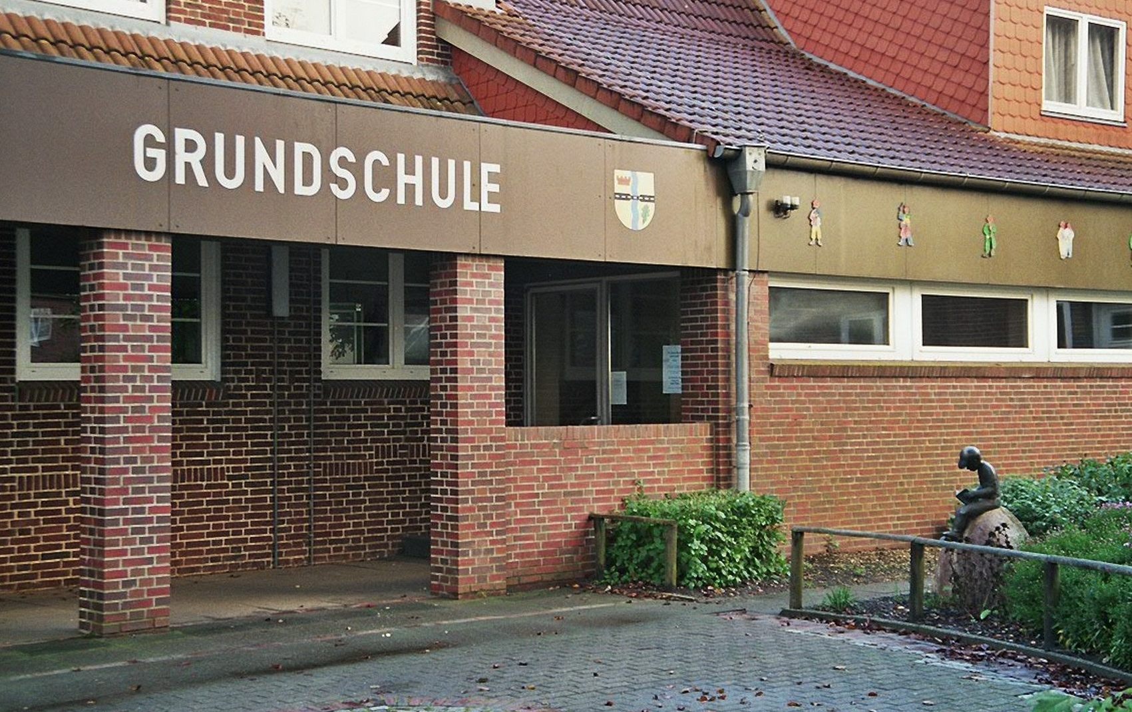
Grundschule
Mandatory and it is for all children between 6 and 10 years old
It lasts for 4 years
It is the equivalent of primary school
Subjects :
German
Math
Science
Art
Music
Sport

Slide 5
After Grundschule
Students can continue their studies in 4 différents secondary schools :
Hauptschule : practicial and vocational education
Realschule
Gymnasium : prepares students for university study
Gesamtschule : combination of all the secondary education mentioned above
The orientation stage (Orientierungsstufe) is mandatory and it help to ensure that students are placed in schools appropriate for their abilities.

Slide 6
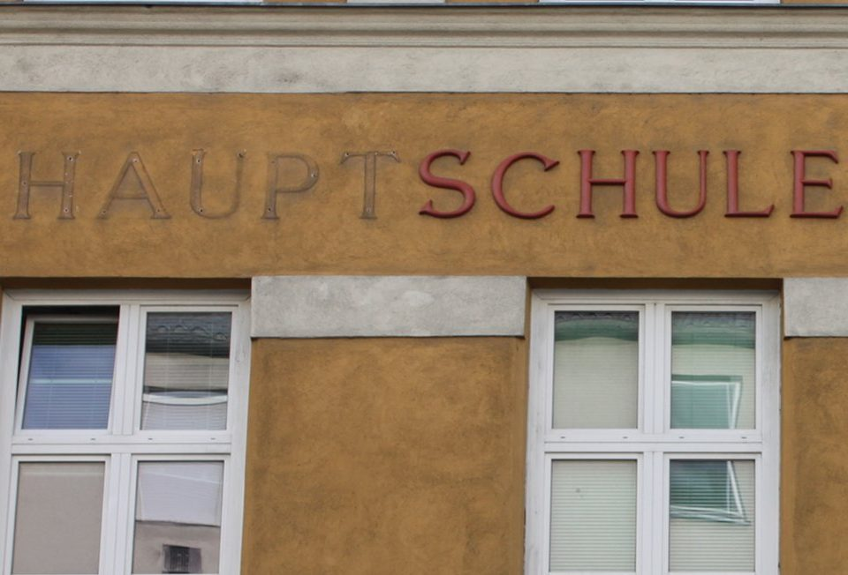
Hauptschule
Lower secondary school
It lasts for five years
Prepare students for vocational education or the workforce
Considered as the least academically demanding of the secondary schools
At the end, they do an exam called Hauptschulabschluss,

Slide 7
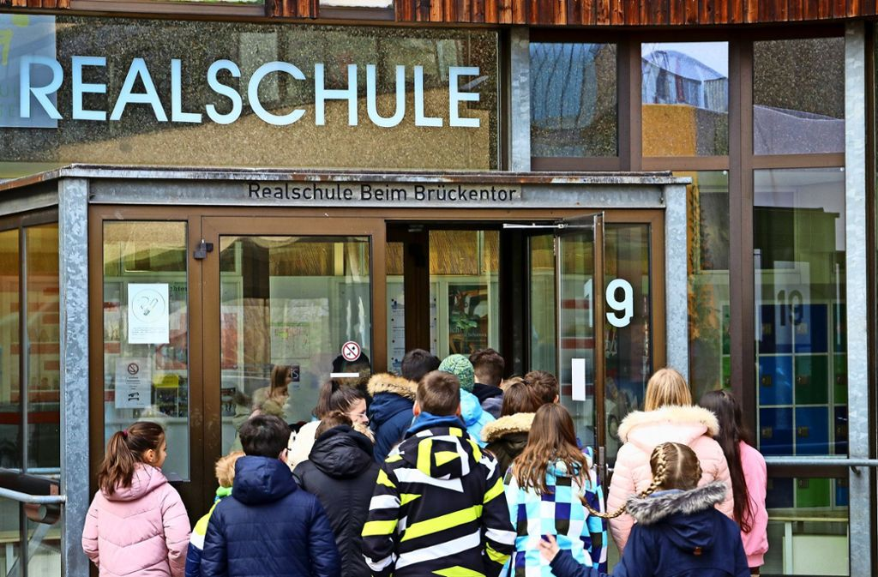
Realschule
Middle secondary school
Practicial and vocational-oriented education
Lasts for 6 years
The main subjects are mathematics, science and technology
The main practicial subjets are business, economics, and computer science
Students have the possibilityto specialize in specifics areas like healthcare
The exam at the end is called Mittlere Reife

Slide 8
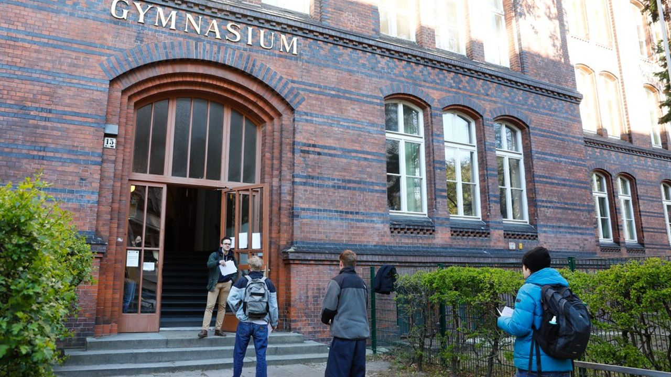
Gymnasium
Upper secondary school
More academic and theoretical education than Realschule
It lasts for 9 years
The main subjects are mathematics, science, language, humanities…
The goal of Gymnasium is to prepare students for higher education at universities or others institutions of higher learning
They are two exams at the end but students do only one of them : the Abitur and the Zentralabitur. One is from the individual schools and the Zentralabitur is a standardized version of the Abitur and it is from the governement

Slide 9
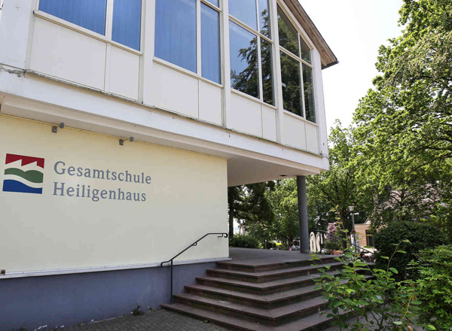
Gesamtschule
Comprehensive school
Combines Realschule and Gymnasium
It lasts for 6 years
The students have the choice between vocational and academic subjects to explore different areas of interest an develop skills and knowledge across a variety of disciplines
After the exam, they can continue their study at the Gymnasium

Slide 10
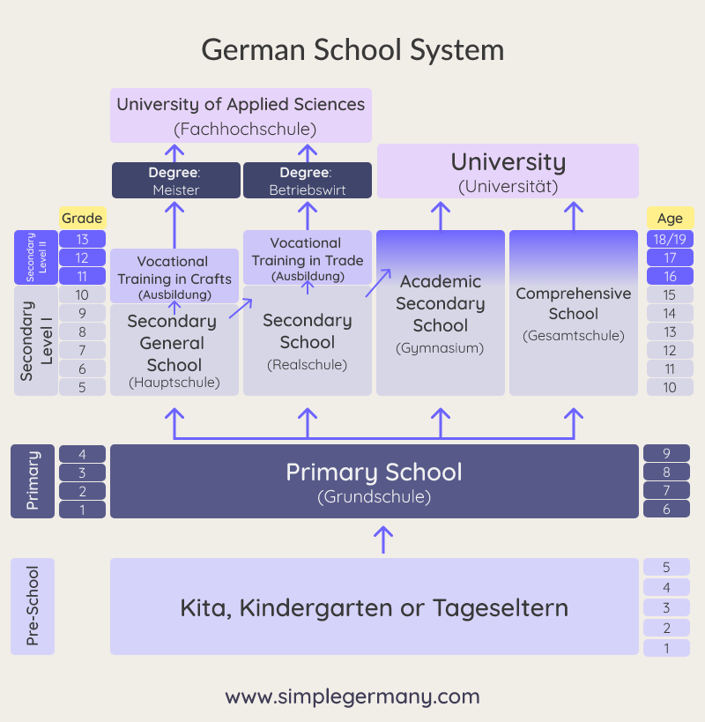
Schema

Slide 11
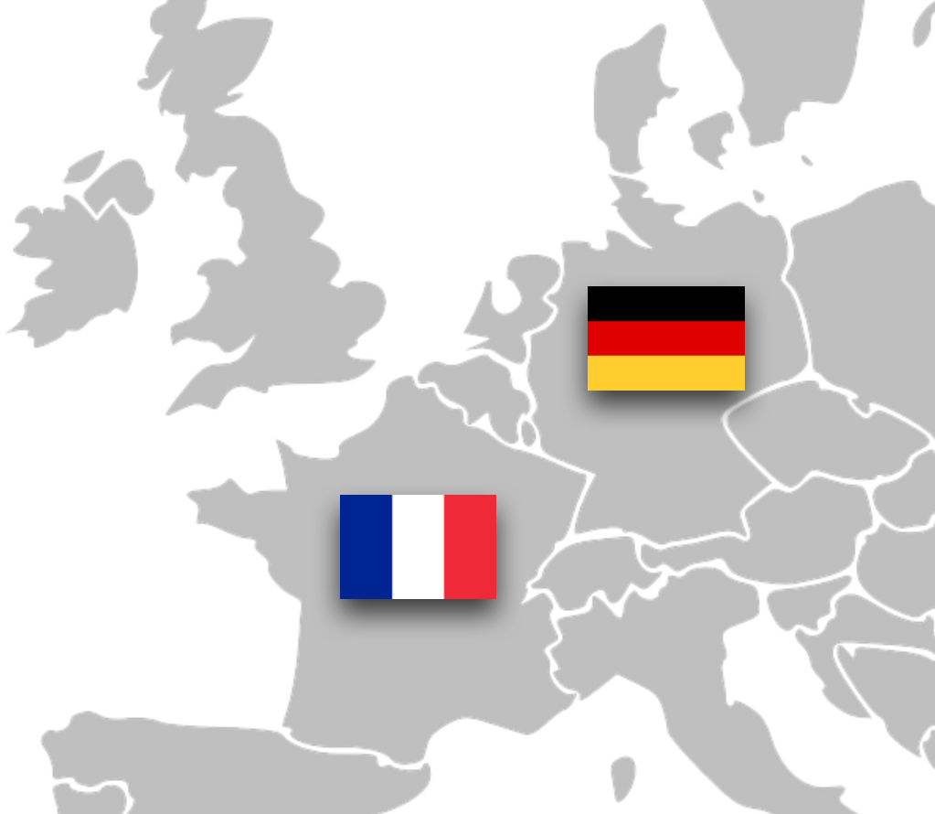
Difference with France
Education is mandatory from 6 to 16 in France while in Germany, it is from 6 to 18.
The French system places a strong emphasis on the humanities, literature, philosophy while in Germany they focus more on science, engineering and mathematics
The grading system in France is based on a scale of 0 to 20. In Germany it’s from 1 to 6 and the passing grade is 4 (equivalent to 10 in France)
In Germany, they generally end school at 2pm

Slide 12
Thanks

